Slide 1
Accessibility Crash Course: Web A11y Basics Applied
Presented By:
Brian McNeilly and James Thompson
CSUN 2018 Assistive Technology Conference
March 22, 2018
Notes:
#a11y is a widely used abbreviation for “accessibility”, and particularly accessibility of digital information, websites, apps, software and devices.

Slide 2
Overview
A11y Crash Course
Keyboard-Only Access
Images
CSS
Reading Order
Roles and ARIA

Slide 3
I. Keyboard-only access

Slide 4

Keyboard-Only Access
A11y Crash Course
Ensure elements that can activated using the mouse can also be navigated to and activated using the keyboard only.
Notes:
This is important, not only for users who cannot see the page but also for those who navigate the web using means other than their hands.

Slide 5
Keyboard-Only Access 2
A11y Crash Course
Keyboard accessible means event handlers for the mouse also handle keyboard keys
onMouseOver == onFocus
OnMouseOut == onBlur
OnClick == onKeyDown keys 13 and 32
Notes:
This is only needed when working with elements that are not natively actionable.

Slide 6
Ii. Images

Slide 7
Image Testing
A11y Crash Course
All images that use the img element need an alt attribute.
Null (empty) alt attributes.
alt=""
All CSS images need HTML equivalents.
Notes:
Provide the alt attribute for img tags, whether they are informative or not. If the image is decorative or redundant the alt value should be empty or null.
https://codepen.io/bpmcneilly/pen/KoWVRo

Slide 8
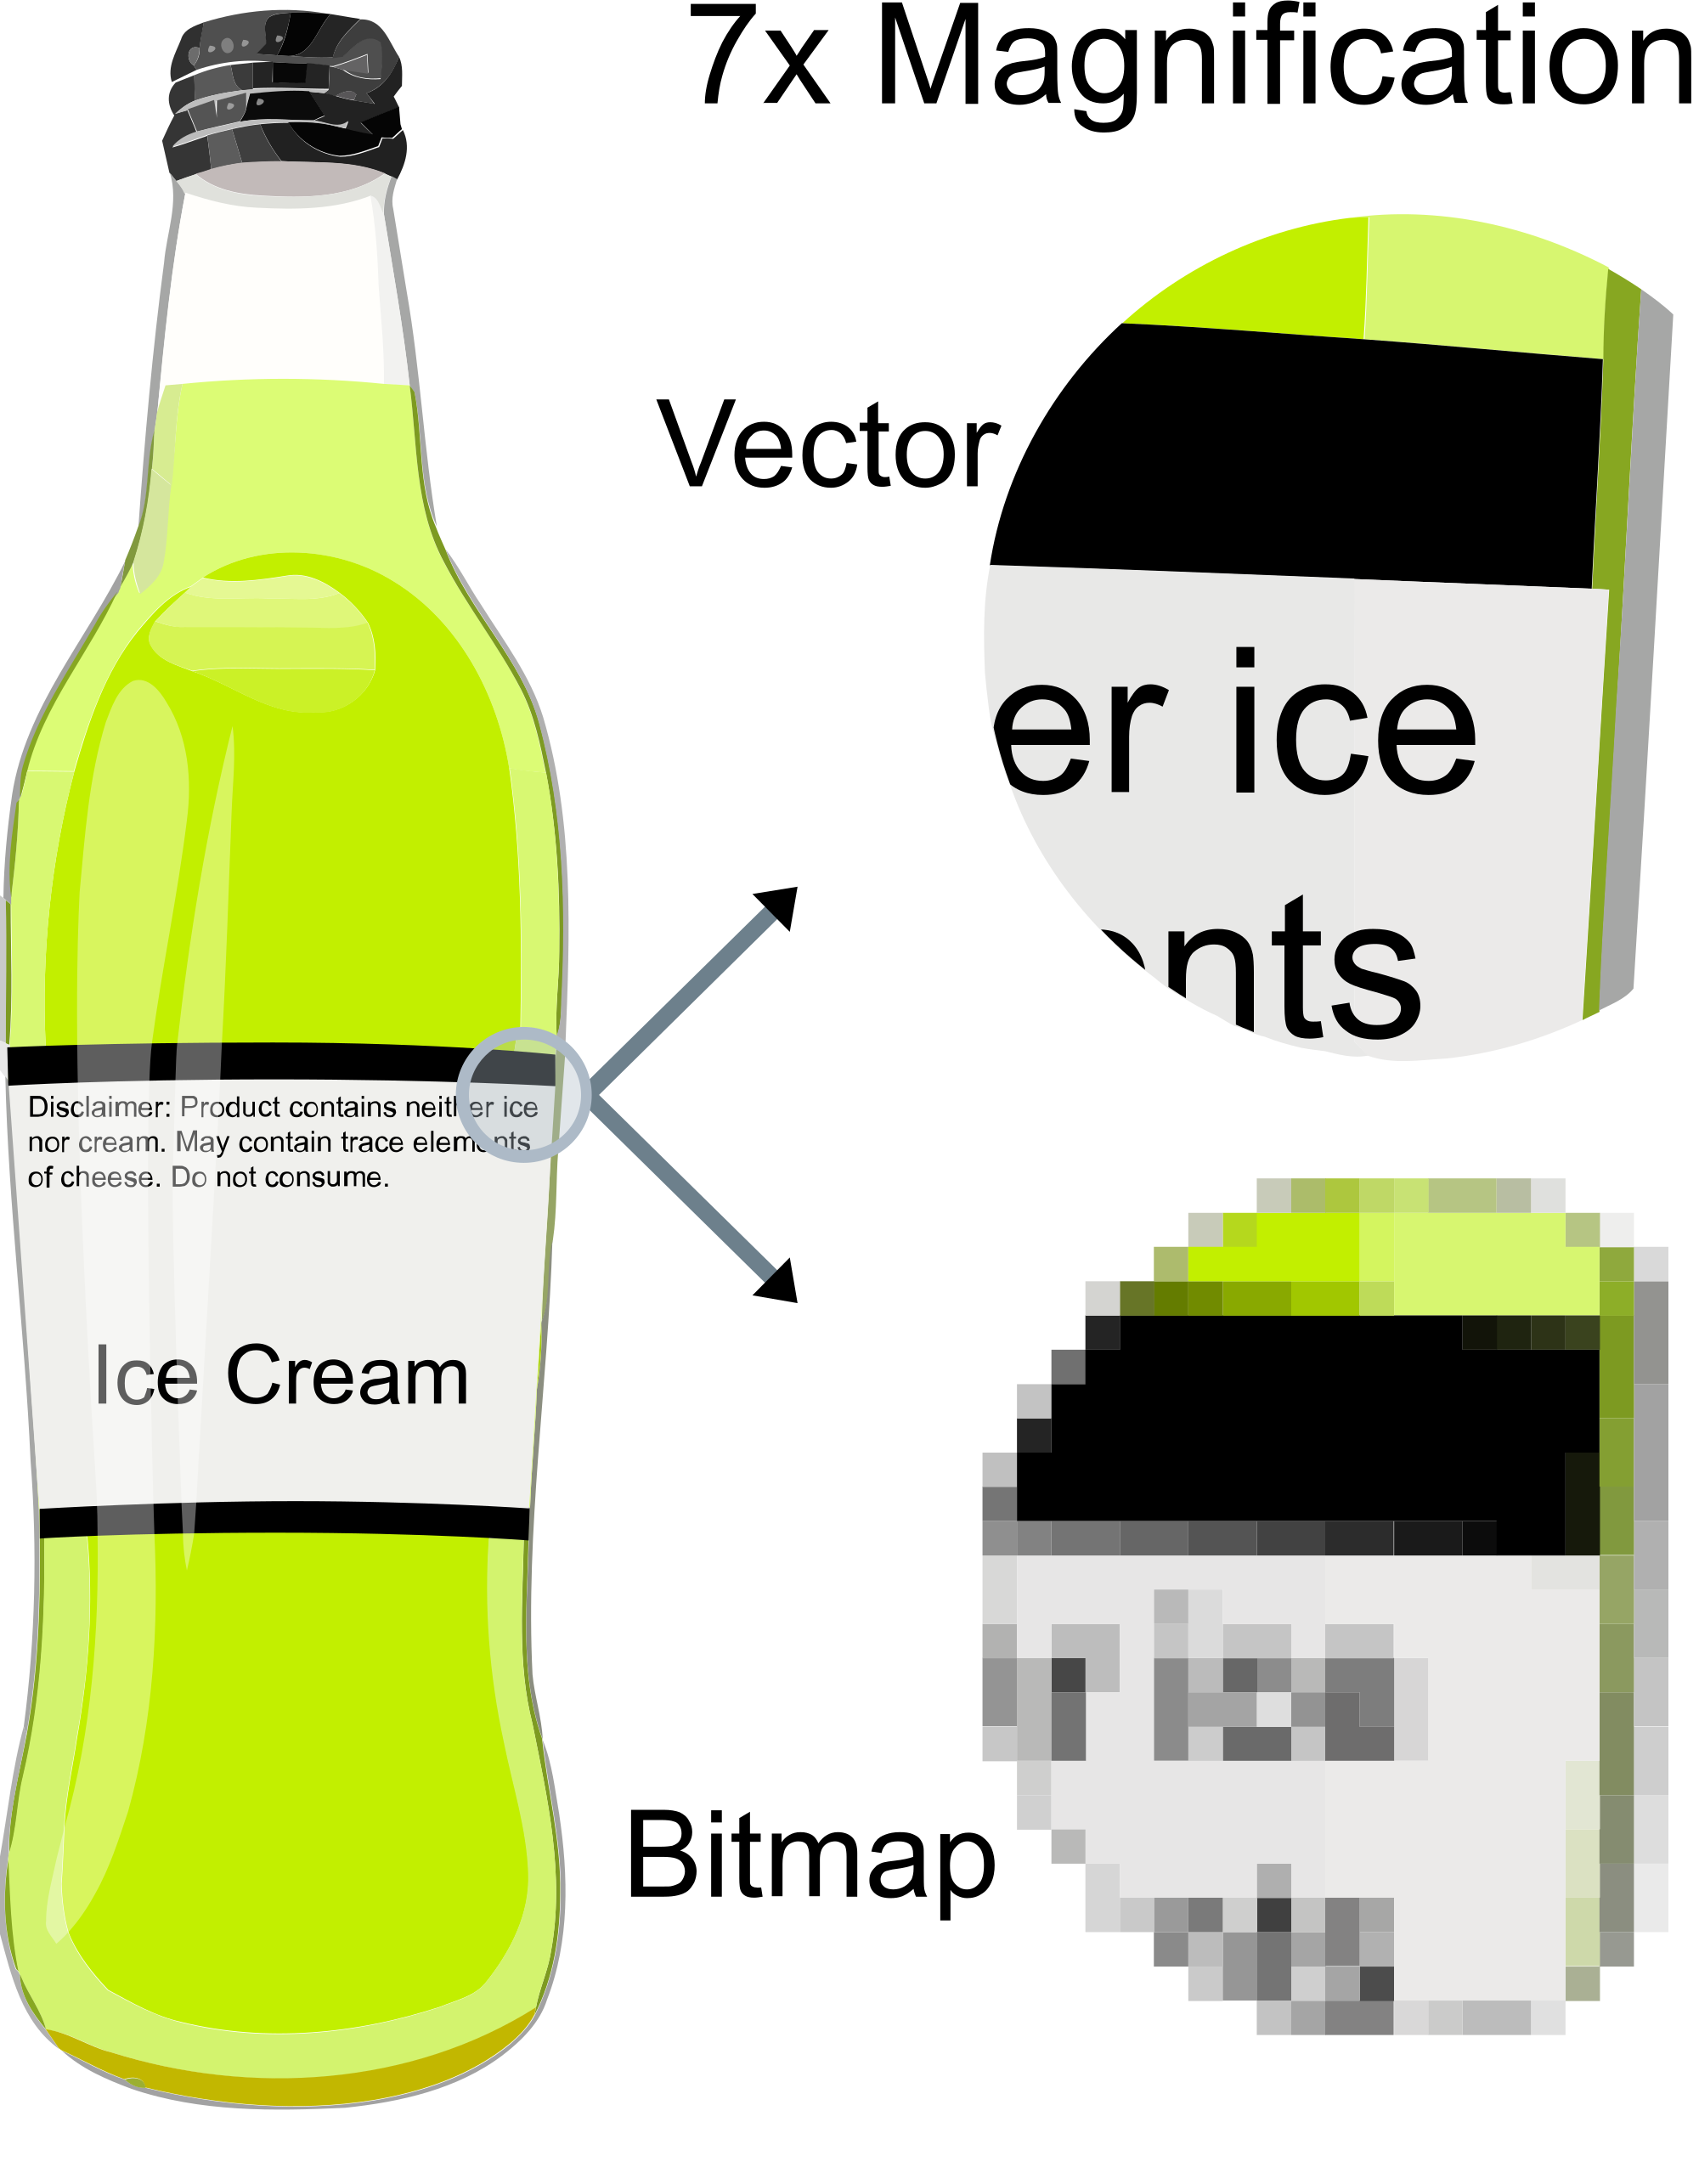
Other Images
A11y Crash Course
SVGs need to use appropriate elements:
<title>
<desc>
ARIA (if necessary)
Don't use images of text!
Notes:
SVGs that are inserted inline need to be treated differently than other images (including svg elements referenced by img elements) because they are "inline" and structural elements can be exposed in the DOM.
The default elements within SVG that will provide information to assistive technology are the title and desc elements. Title, as someone might expect provides a name for the SVG icon, while the desc provides a supplemental description.
ARIA (which we will discuss a little more later) can also be used as a means to label SVG elements!
Images of text are sometimes very popular, especially in some finance & retail situations, but these images pose a number of problems for people with disabilities. Often alt attributes for images of text don't expose EVERYTHING in an image, and unlike explicit text, images of text will not scale when users magnify their screen, resulting in text that is harder to read. An example of this is illustrated in the magnified "bitmap" image at right.
Because we're talking about SVGs and images of text, it’s worth mentioning, the SVG "text" element is considered programmatic text and isn't the same as a classic "image of text".

Slide 9
iII. CSS

Slide 10
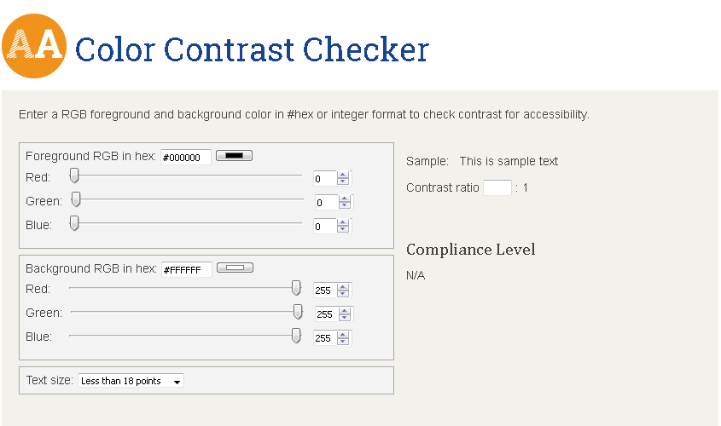
CSS & Color Contrast
A11y Crash Course
Color Contrast for text and keyboard focus
https://www.levelaccess.com/compliance-resource/color-contrast-checker/
This is an example of poor contrast. It is not a great example as it cannot really be read. If you can read this
Notes:
One of the most popular things to do with CSS is adjust color contrast.
If you came to our earlier presentation, some of you may recognize the image we have up on this slide. Low color contrast is something that is encountered a lot and can be fairly easily fixed (especially if accessibility is addressed early on)
Sufficient color contrast, and noticeability is very important for keyboard focus indicators. Without these, sighted keyboard-only users will be unable to see where they have keyboard focus.
While browsers generally provide sufficient contrast, in some instances content creators must define focus indication themselves. This requires the use of the "outline" CSS property set when elements receive focus.

Slide 11
CSS - Visible and Invisible Text
A11y Crash Course
The differences between:
display:none
Not visible, nor heard.
visibility:hidden
Not visible, but takes up space and MAY be heard.
Off-screen text
Not visible, but heard.
Notes:
The most used screen readers support both CSS properties, however older, less well-known screen readers may not support everything as consensus generally holds.

Slide 12
IV. Reading Order

Slide 13
Reading Order
A11y Crash Course
Ensure the reading order corresponds to the visual order of the page.
Notes:
Make sure that CSS is not used to move content visually. Especially when dealing with dialogs.

Slide 14
Reading Order (cont’d)
A11y Crash Course
Ensure focus order follows the reading order of the page.
Do not use positive tabindex values unless absolutely necessary, instead change the order the code.
Move keyboard focus to opening modal dialogs
Notes:
Use tabindex=0, if positive values are used anywhere, they must be used everywhere and all values need to be updated whenever elements are moved or changed.
The Cat Analogy
Make sure focus moves appropriately within dialogs and modal dialogs.

Slide 15
V. Roles & Aria

Slide 16
Element Roles
A11y Crash Course
What is a role?
Does everything have a role?
How do I pick the right one?
Interactive Roles & ATs
Code Examples:
<button>Click me!</button>
<a id="sample">Learn about examples</a>
<input type="text" />
Notes:
A role is a way to understand what a component is, and what to do with it.
Everything has a role, but lots of them are implicit – in web documents, standard text is expected to be in paragraph form, so this won't be announced
Using standard HTML controls, roles will be assigned appropriately – if you use an HTML list, ATs will be exposed to a list, use a button, ATs will be exposed to a button
Interactive roles are some of the most important to get correct as without them, AT users will not be able to effectively interact with items on a site.
A couple of examples appear on the right, one of which will not supply an interactive role, anyone have any guesses?
It's the second item – this is included because it's something I've seen a number of times, if you include an "a" element without an "href" attribute the element will be exposed as text, and not exposed to ATs as a link!
https://codepen.io/bpmcneilly/pen/BrWKwV

Slide 17
ARIA-* Attributes
A11y Crash Course
The Big Four:
aria-label (string)
aria-labelledby (space separated list of ids)
aria-describedby (space separated list of ids)
aria-hidden (true)
Other handy attributes:
aria-expanded (true or false)
aria-live (off, polite, or assertive)
aria-hidden *refresher*
Notes:
ARIA-* attributes will be helpful to provide additional context to items when you can't add this in other ways
Aria-label will let you manually specify a label directly. This is in contrast to the next item, aria-labelledby which requires you to reference ID attributes of elements on a page (the real advantage here is when you want to label something with text already on a page)
Aria-describedby works like aria-labelledby, but only provides additional explanatory text. This can be helpful when assigning supplemental text to explain an interactive element.
Aria-hidden lets you hide content from ATs that is visually displayed. This is basically the inverse of off-screen text that we talked about earlier. If there's something on-screen that is extra & you want it hidden
A few other aria-* attributes exist, and can be helpful here and there. Most notably, aria-expanded & aria-live. The latter will let you announce if content has a state, expanded or collapsed, and which state it is currently in. This comes in a lot of handy for dialogs and similar content. Aria-live will provide live updates to content contained within the "live region". These are helpful for status messages, and also content that you know will be updating and providing important information everyone should see.
https://codepen.io/bpmcneilly/pen/pLeydB

Slide 18

ARIA Roles & Visual ARIA
A11y Crash Course
ARIA Roles:
With Great Power, Comes Great Responsibility
Create complex widgets, unavailable within native HTML.
When (and when not) to use ARIA.
How do I know I've done it right?
Notes:
Instill some "Fear of God" about how much you can fuck up a page with ARIA
"With great power comes great responsibility".
How do I know I've done it right? Cue NEXT SLIDE

Slide 19
Visual ARIA Testing
A11y Crash Course
If your product uses ARIA:
Use the Visual ARIA Bookmarklet.
Can be found at: http://whatsock.com/training/matrices/visual-aria.htm
Tab through all custom widgets, open menus, etc.
Notes:
VISUAL ARIA to the RESCUE
Tools will definitively help you with respect to what content is coded correctly or not :)

Slide 20
Questions

Slide 21






Thank You!
A11y Crash Course
Contact Us
Follow Us
Brian McNeilly
Brian.McNeilly@LevelAccess.com
@LevelAccessA11y
Level-Access
James Thompson
James.Thompson@LevelAccess.com
Level Access
Level Access Blog
Slide Deck Available for Download at: https://www.levelaccess.com/csun18/

